Slide 1



Bank CRM Development Analysis
Aadarsh Katiyar

Slide 2

Introduction
Welcome to the presentation of this analysis project, which aims to improve the bank's retention strategy by better understanding customer behaviour. Utilizing data insights is essential for maintaining competitiveness and guaranteeing long-term success in today's changing industry, where consumer loyalty is key. This project focuses on analyzing various aspects of customer interactions, financial behaviors, and demographic trends to derive actionable insights. By exploring the customer churn patterns, spending habits, and response to marketing initiatives, I aimed to develop strategies that not only retain existing customers but also attract new ones.
The project utilizes a robust dataset encompassing customer information, transaction details, credit scores, and demographic profiles. Through advanced analytics and visualization techniques, I have uncovered valuable insights that will guide in making data-driven decisions to optimize customer satisfaction and business growth.
Let's dive into the details of our data journey and explore the insights that will drive into the strategic initiatives going forward.

Slide 3

Summary
"This project delves into customer churn and retention analysis within a bank, employing data-driven insights to uncover trends and patterns influencing customer behavior. By examining factors like demographics, account activity, and product usage, the project aims to identify high-risk customer segments and propose targeted strategies for enhancing customer retention. The ultimate goal is to leverage data analytics to optimize customer satisfaction, reduce churn rates, and drive sustainable growth for the bank."

Slide 4



Analytical Approach & Tools
Data Cleaning and Formatting
Used Excel for initial data cleaning tasks, including removing duplicates, and formatting columns for consistency.
Conducted data profiling to understand the dataset's structure, identify patterns, and assess data quality.
Data Storage and Manipulation
Imported the Excel Data into SQL database
Analyze the customer churn by writing SQL Queries to correlate customer attributes with the churn rates.
Data Analysis and Visualization
Used the queries and original files to process data in Power BI
Develop interactive dashboards to display balance details, churn rates and customer details.

Slide 5



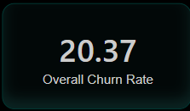
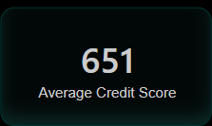
Overview of the Customers
Total Customers
Churn Rate
Average Credit Score

Slide 6
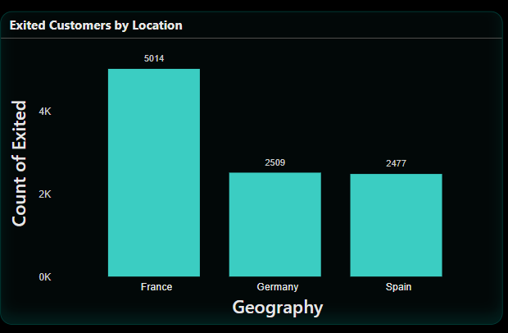
Churned Customers by Countries
The chart displays the count of customers who have exited based on their geographical location, specifically focusing on three countries: France, Germany, and Spain. The chart visually represents the number of exited customers in each country, with France having the highest count, followed by Germany and then Spain. The bars in the chart provide a clear comparison of the exit counts across the three countries, with France having the largest number of exited customers.

Slide 7
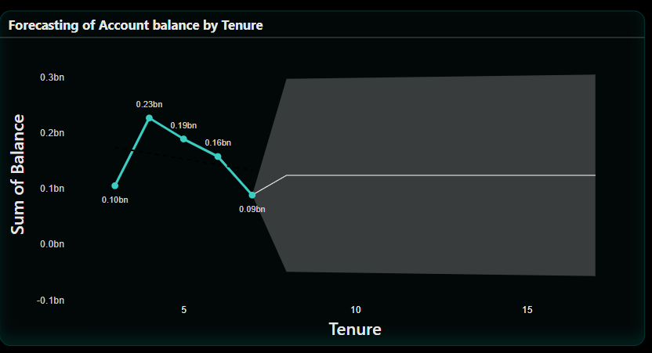
Forecasting of Account Balance
It displays the relationship between the tenure of an account and the sum of the account balance, presumably forecasting future balances based on the length of the account's existence.
The graph suggests that the account balance is expected to increase in the first few years, suffer a decline around the 5-year mark, recover somewhat, and then stabilize or decrease slightly after around 10 years. The shaded area suggests that the most reliable forecast is within the first 10 years.

Slide 8
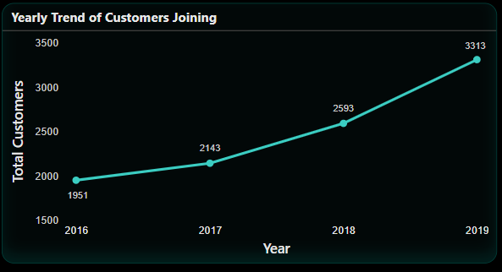
Yearly Trend of Customers Joining
The number of customers who joined each year from 2016 to 2019. The X-axis represents the years, while the Y-axis represents the total number of customers. The graph indicates a positive trend with an increase in the number of customers joining each year:
In 2016, there were 1951 customers.
In 2017, the number increased to 2143 customers.
In 2018, the total customers grew to 2593.
By 2019, the number reached 3313 customers.
The data points are connected by a line to show the trend of customer growth over the four-year period. The graph illustrates consistent growth in the number of customers joining each year, indicating a positive trend in customer acquisition

Slide 9
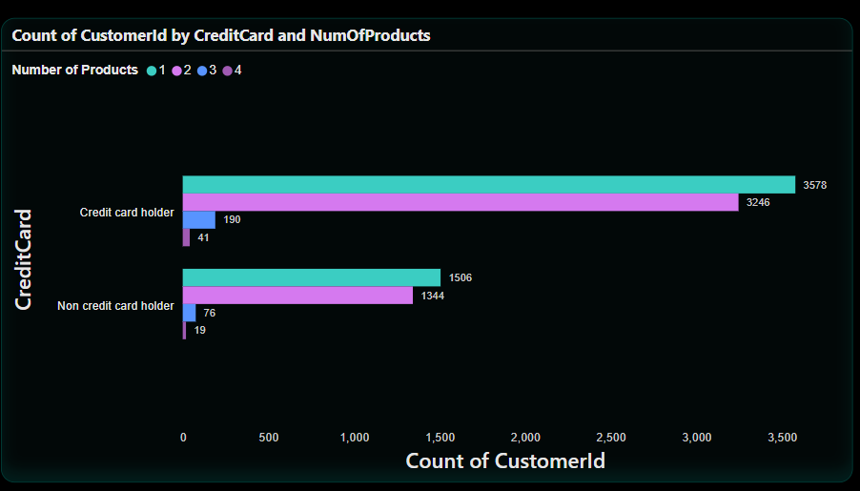
Count of Number of Products by Credit Card Status
The number of customers categorized by whether they are credit card holders and by the number of products they have (ranging from 1 to 4 products).
Credit card holders with:
1 product: 3,578 customers
2 products: 326 customers
3 products: 41 customers
4 products: Not visible in the graph, possibly 0 or a negligible number
No credit card holders with:
1 product: 1,596 customers
2 products: 134 customers
3 products: 76 customers
4 products: 19 customers
The graph visually represents the distribution of customers based on their credit card status and the number of products they have. It provides insights into the customer segmentation and the prevalence of different product ownership levels among credit card holders and non-credit card holders.

Slide 10
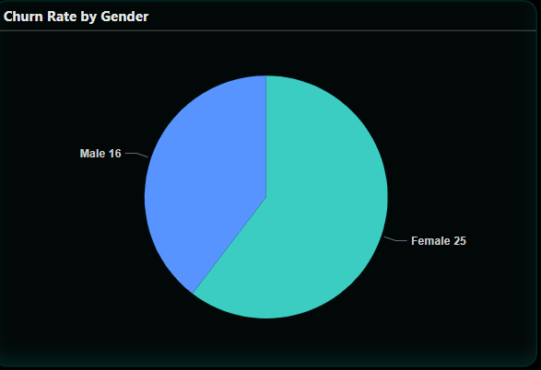


Churn Rate by Gender
The below PIE Chart displays the Churn Rates according to the Genders
16
25

Slide 11
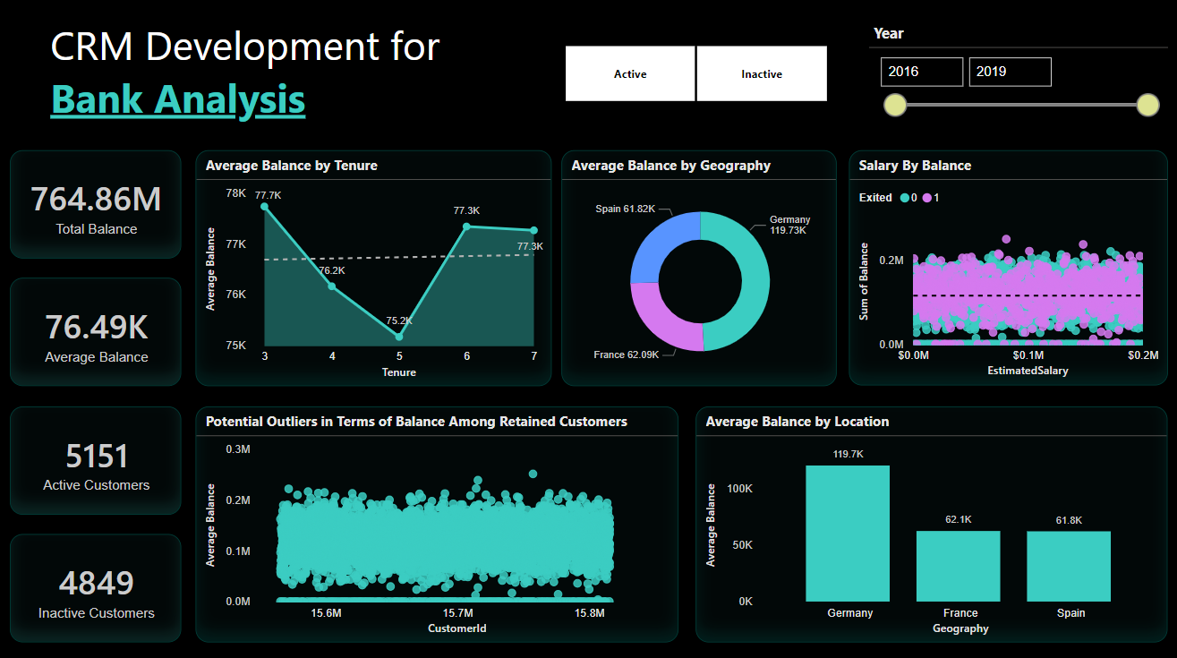
Dashboard and Visualizations
Balance Details
The main page of the Dashboard which shows the details about the customers balance

Slide 12
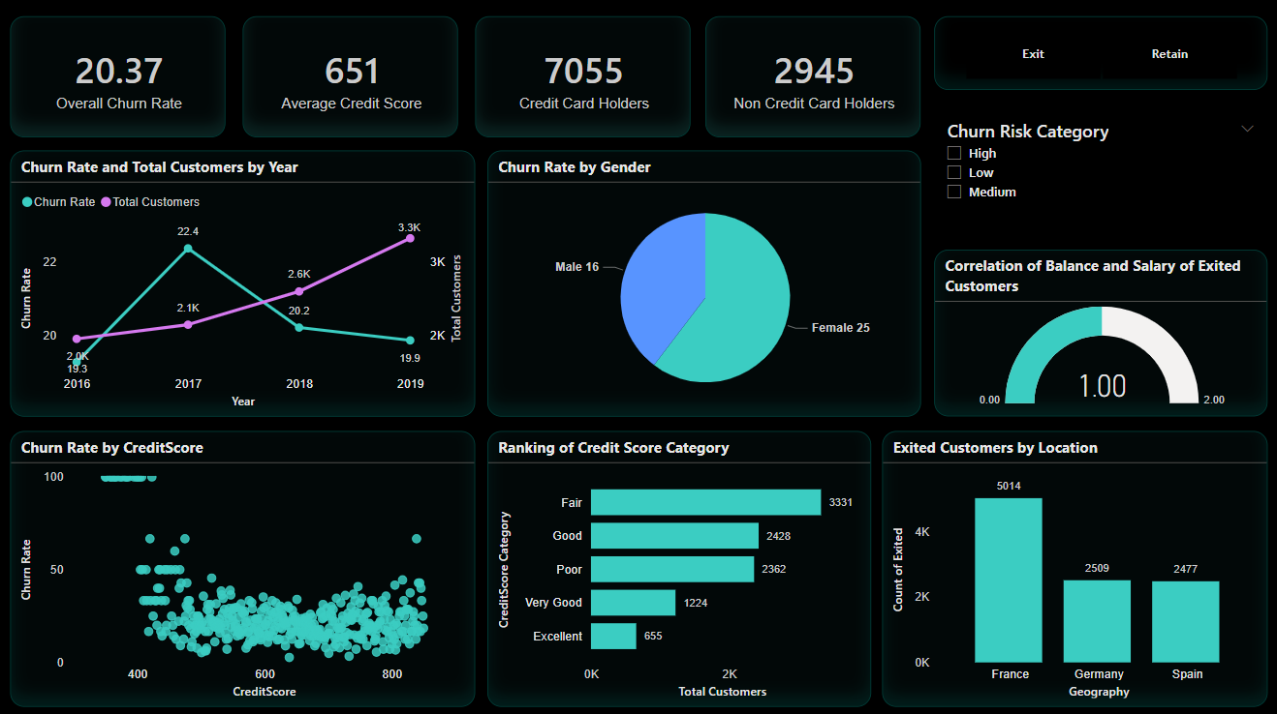
Dashboard and Visualizations
Churn Rate
This page will show the details according to the churn rate of customers from the bank. Which will give insights about the customers discontinuing the bank products and services.

Slide 13
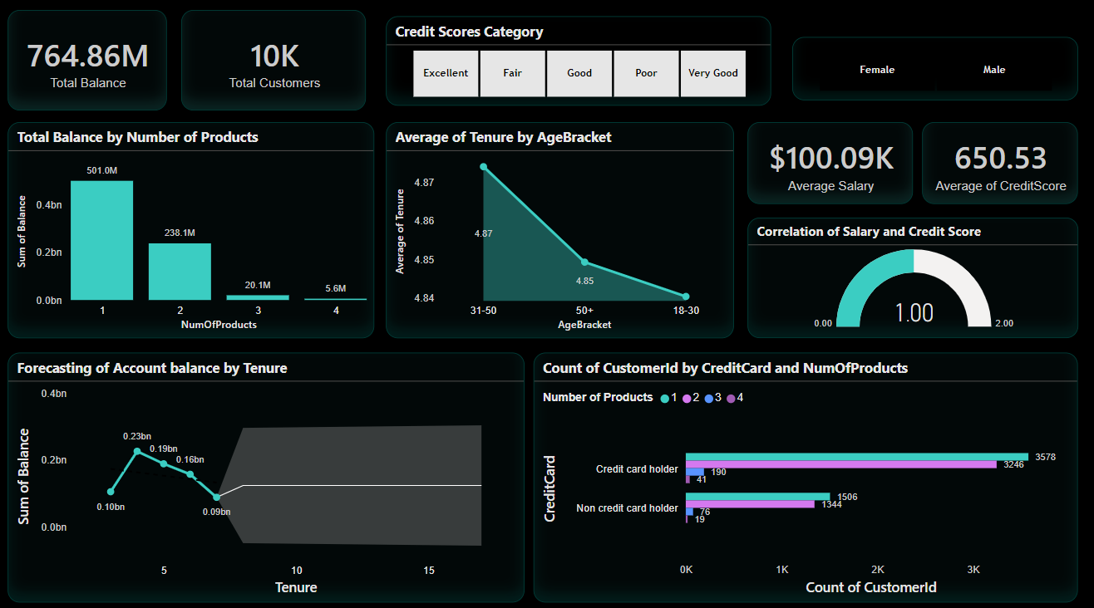
Dashboard and Visualizations
Customer Details
This page will give insights about the details of the customers in the bank.

Slide 14
Conclusion
The project delved into the intricacies of customer churn analysis within the banking sector. We gained valuable insights into customer behaviors, risk factors, and market trends. We identified key metrics such as churn rates, customer demographics, and product usage patterns, enabling us to formulate data-driven strategies for customer retention and acquisition.
However, it's crucial to note that customer churn is a complex phenomenon influenced by various factors beyond the scope of our dataset, such as customer experiences, market competition, and economic conditions. Therefore, while our analysis provides valuable insights, a holistic approach incorporating customer feedback, qualitative data analysis, and continuous monitoring is essential for sustained success in reducing churn and enhancing customer satisfaction.

Slide 15



Thank you

